Slide 1





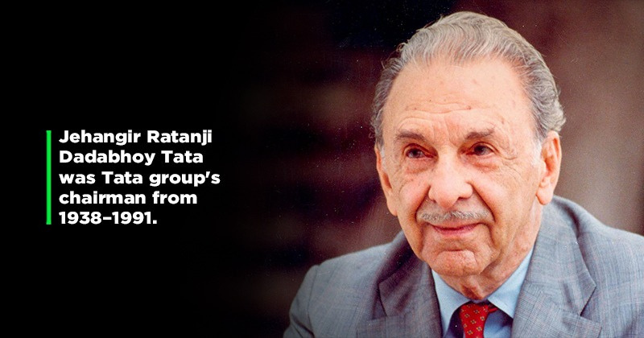




Death Anniversary of
J.R.D Tata
29 July 1904 –
29 November 1993

Slide 2

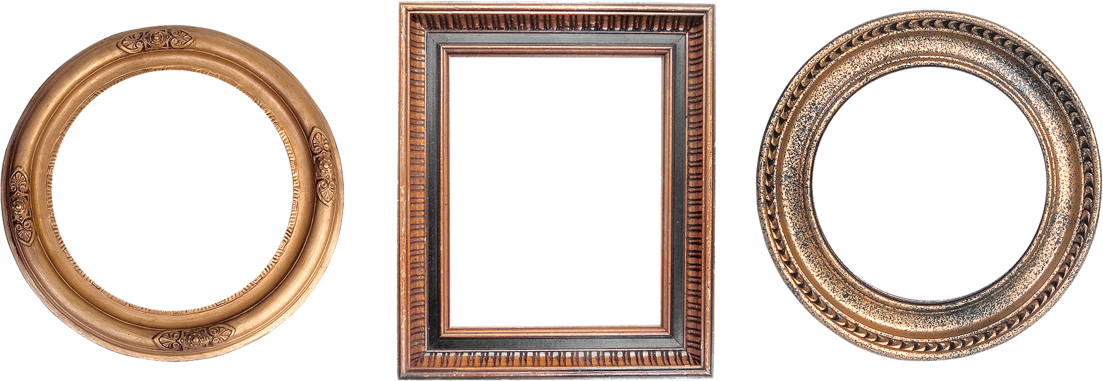

Slide 3

CARS

Slide 4

CARS
IT
COMPANY

Slide 5
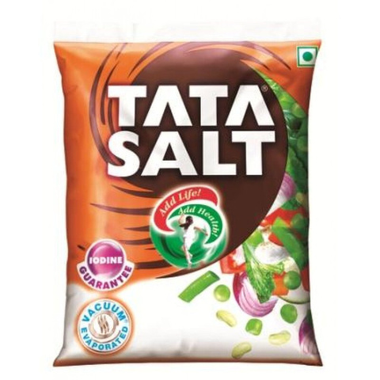
CARS
TATA
SALT
IT
COMPANY

Slide 6
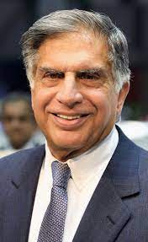



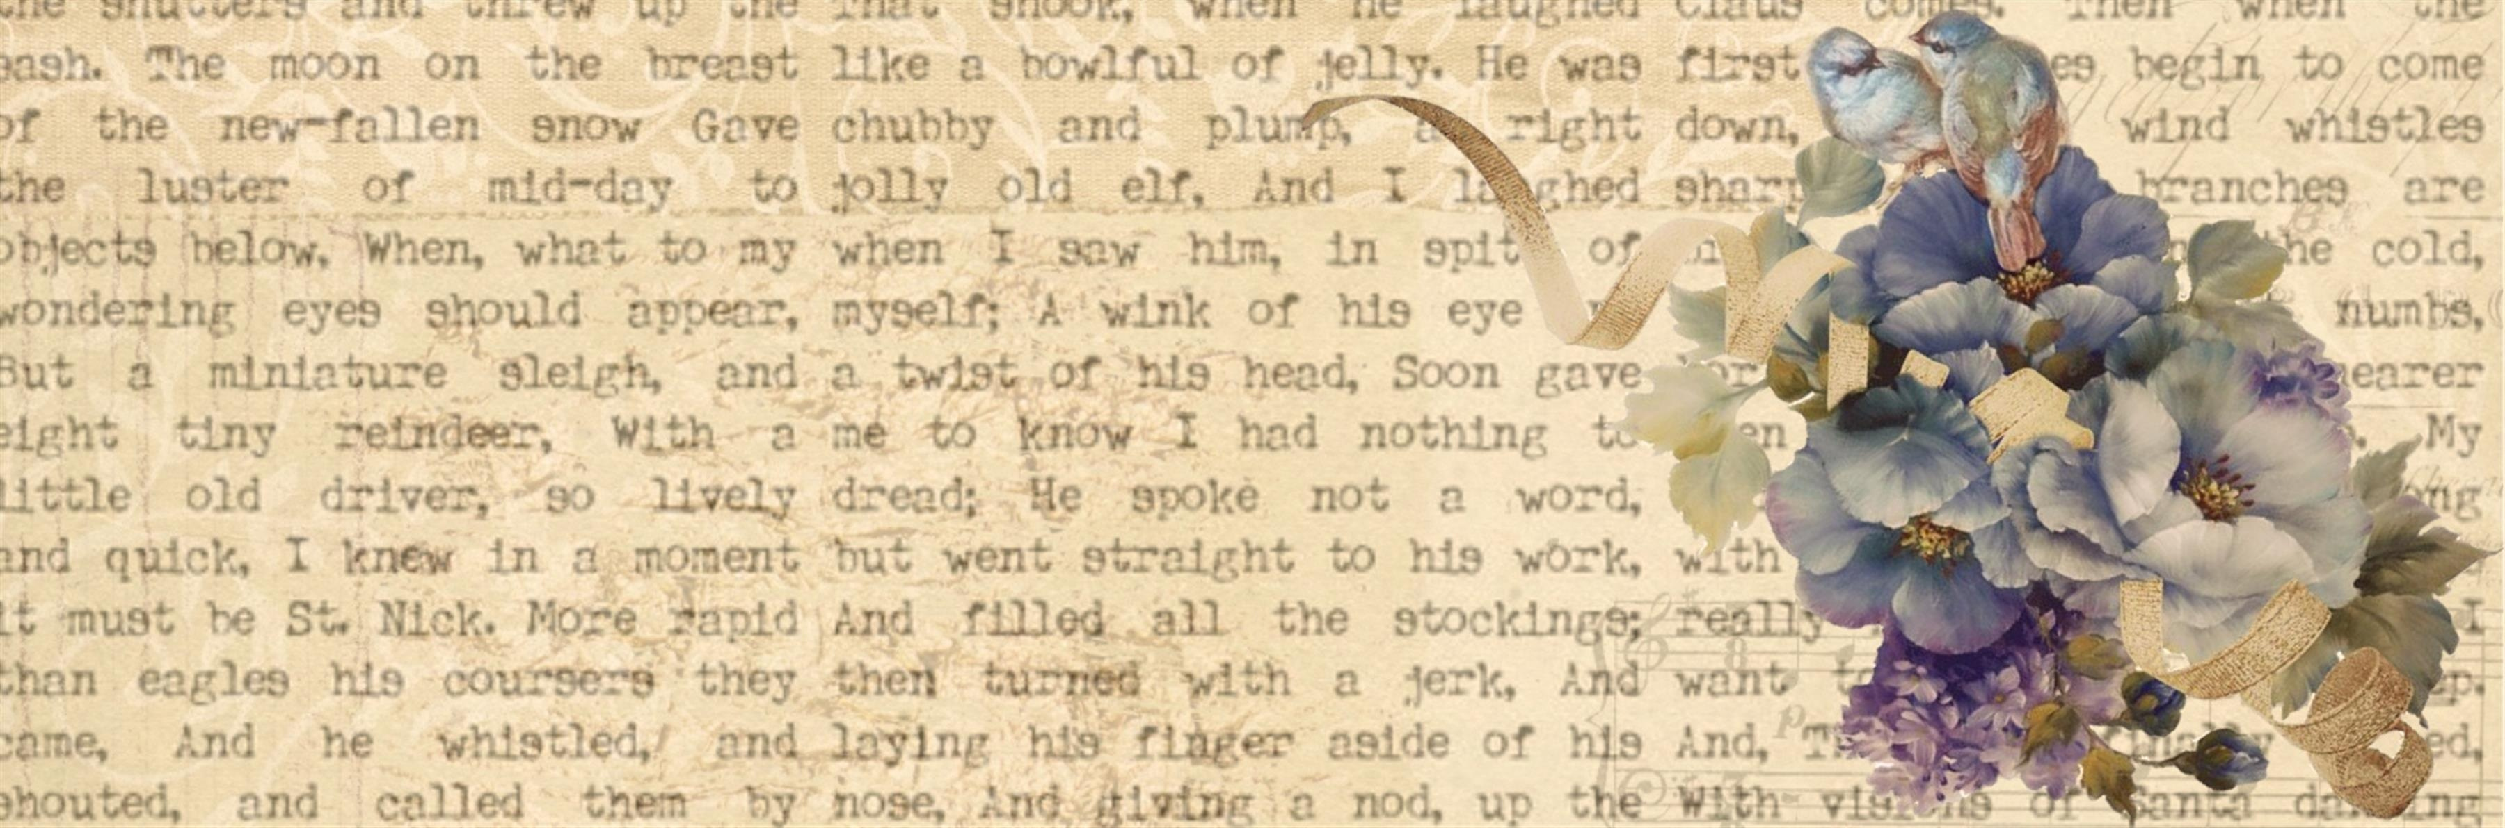
Ratan Tata
visionary leader
successor
of JRD Tata

Slide 7
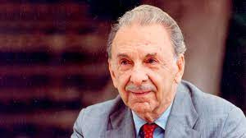
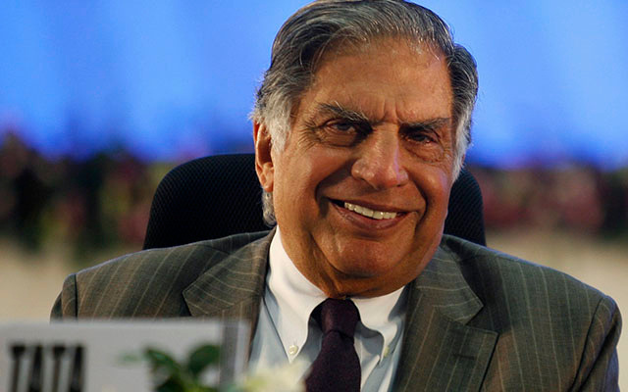
FATHER
SON

Slide 8


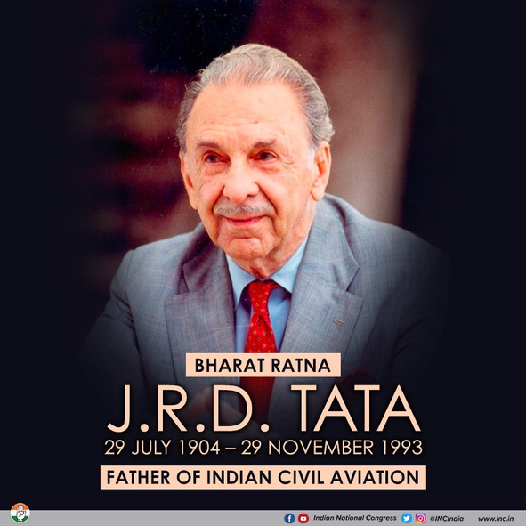

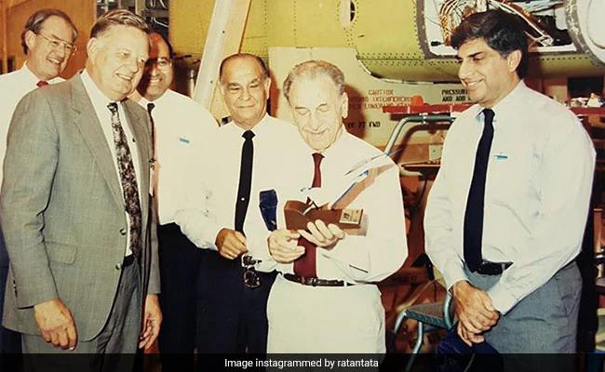
First Indian Businessman
to receive the Bharat Ratna

Slide 9

Indias’s First...

Slide 10
Indias’s First...
Pilot Licence - 1929

Slide 11
Indias’s First...
Pilot Licence - 1929
Commercial Airline - 1932

Slide 12
Indias’s First...
Pilot Licence - 1929
Commercial Airline - 1932
Bharat Ratna - 1992

Slide 13
Indias’s First...
Pilot Licence - 1929
Commercial Airline - 1932
Bharat Ratna - 1992
Cancer Hospital - 1941

Slide 14
Indias’s First...
Pilot Licence - 1929
Commercial Airline - 1932
Bharat Ratna - 1992
Cancer Hospital - 1941
TIFR research Centre

Slide 15
Indias’s First...
Pilot Licence - 1929
Commercial Airline - 1932
Bharat Ratna - 1992
Cancer Hospital - 1941
TIFR research Centre
8 Hours Working Shift

Slide 16
Indias’s First...
Pilot Licence - 1929
Commercial Airline - 1932
Bharat Ratna - 1992
Cancer Hospital - 1941
TIFR research Centre
8 Hours Working Shift
Provident Fund for workers

Slide 17

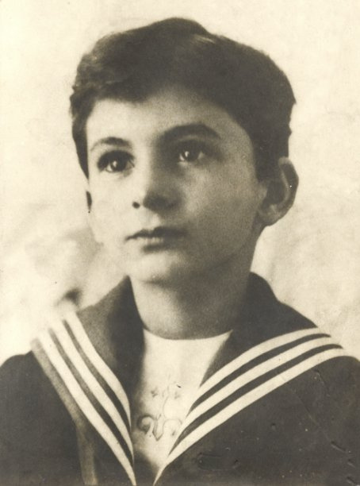

A Child with a
DREAM

Slide 18
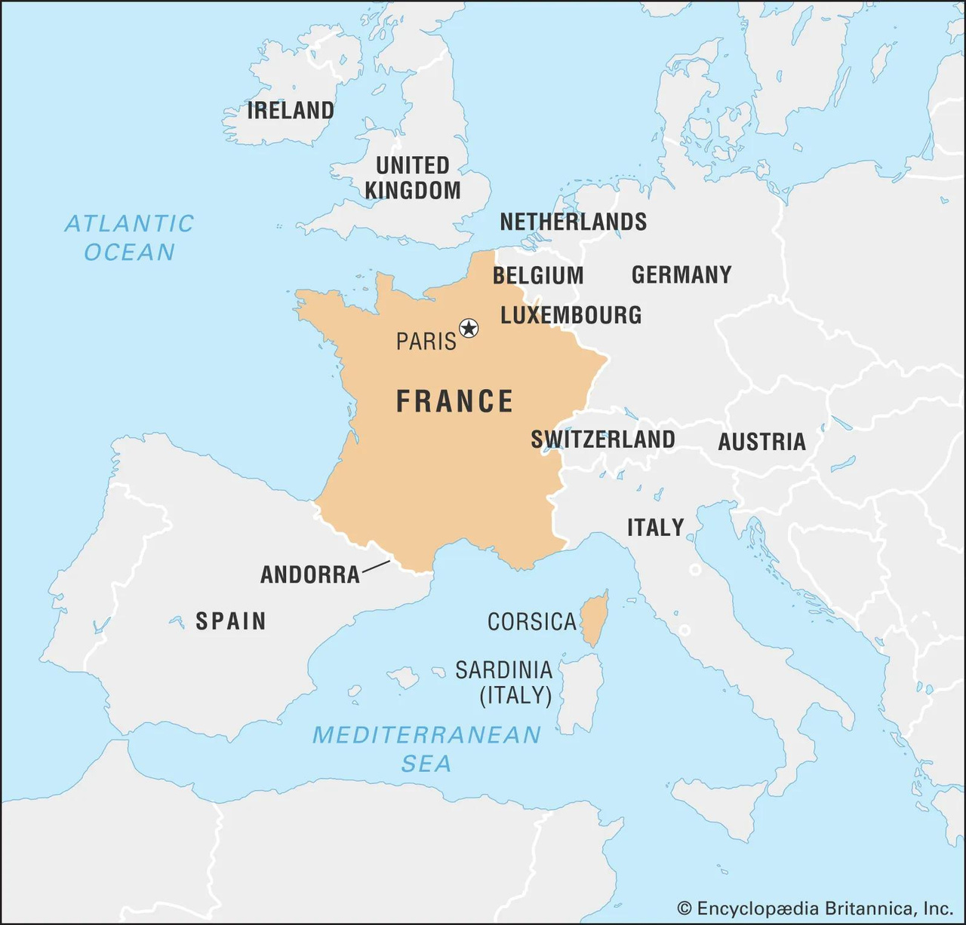


Slide 19

Age : 15
DREAM

Slide 20

Age : 15

Slide 21

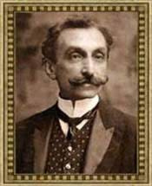
We have to shift to India...

Slide 22
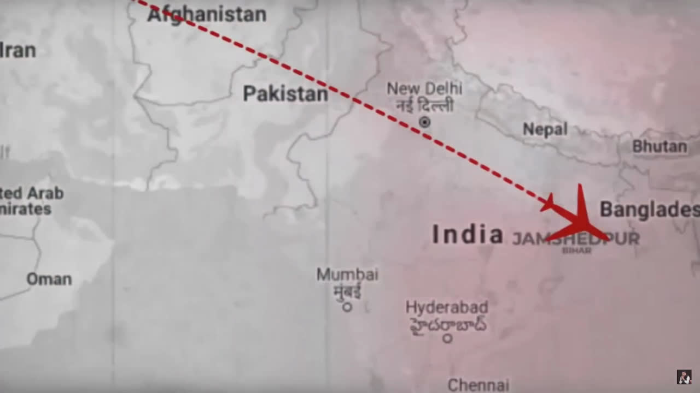

Slide 23
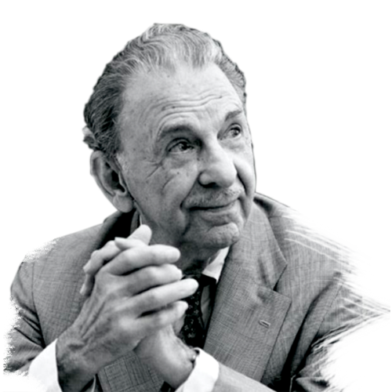
What did he do when he came to India?

Slide 24
He worked as a peon.
as unpaid
staff

Slide 25
After getting slowly promoted and
going throught that struggle
he learned
Workers Psyche
Ground
Struggle
Value
of
Wealth
Team
Building

Slide 26
Another Challenge ...

Slide 27
He lost his father ...
at the age of 22

Slide 28
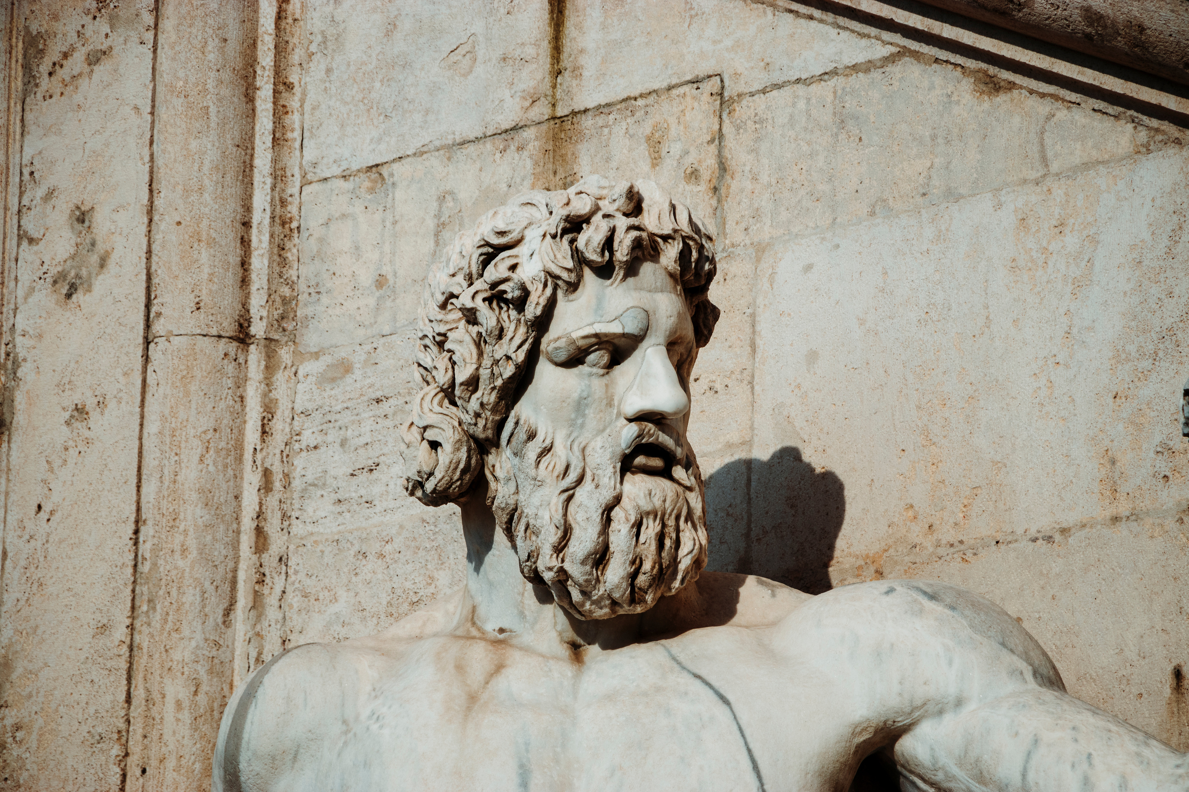
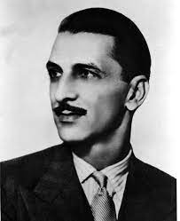

He was appointed as
Director
at Tata Sons

Slide 29
We can talk for hours about his lifestory
but I have to stop here with his lifestory
BUT...

Slide 30
I would DEFINITELY love to add one
Life Incidence and Change he made
To make this event more worthwhile and enjoyable

Slide 31
Change in Industry
when it came to women's
Empowerment

Slide 32

NEWS
PAPER

Slide 33
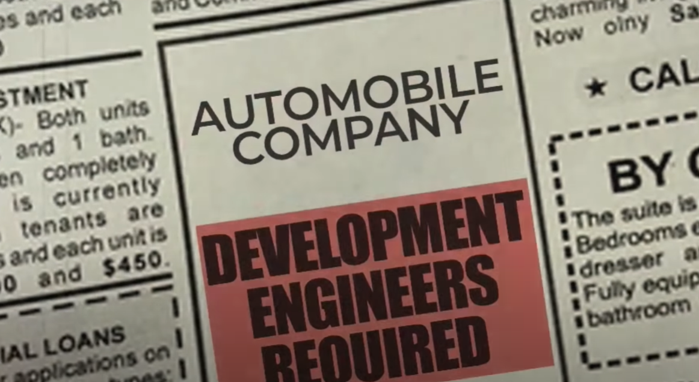


Slide 34
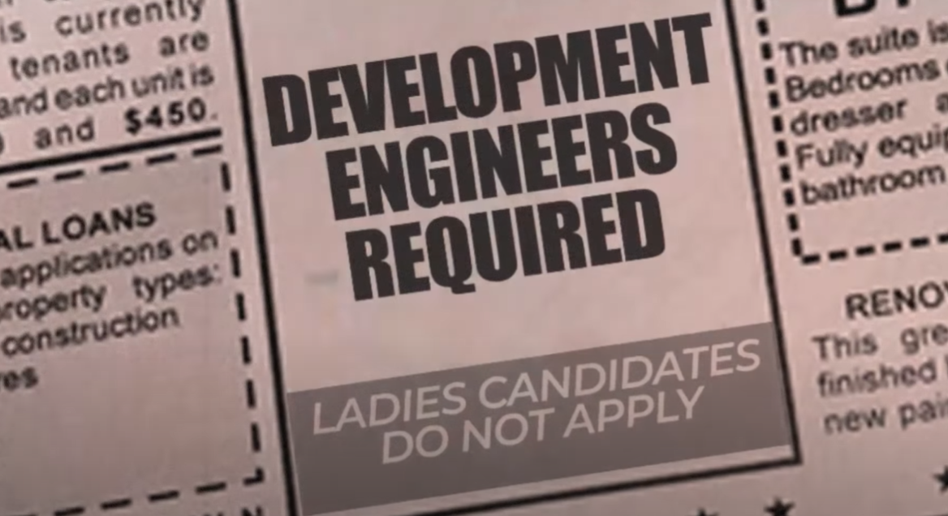

Slide 35



Slide 36
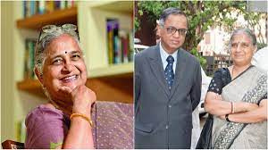
Sudha Murti Ji

Slide 37

From THAT day...
Females were permitted for that job too!

Slide 38
Thank
you

